Slide 1
Acardio AKS - Sekundärprevention
BR-2772-11/17SE
Utbildningsmaterial
Utbildningen har gjorts i samarbete med specialister inom kardiologi från olika delar av landet.
Patientfallen representerar inga enskilda specifika patienter utan är konstruerade för att utgöra olika
typfall med syfte att belysa terapiområdet akut kranskärlssjukdom (AKS).
Notes:
995.731.011_08/16 SE

Slide 2
Dagens program
Bedömning
Xx
Xx
Xx
Xx
Xx
BR-2772-11/17SE

Slide 3
Bedömning
Sekundärprevention efter kardiovaskulär sjukdom
BR-2772-11/17SE

Slide 4
Bedömning
Riskvärdering
Primär/Sekundär prevention
Vad är sekundärprevention?
Sekundärprevention
Prevention vid etablerad kardiovaskulär sjukdom (CVD)
Alternativt
Kontinuerligt riskspektrum; bedömning av risknivå* (ESC 2016)
BR-2772-11/17SE
* Piepoli MF et al, Eur Heart J. 2016. doi:10.1093/eurheartj/ehw106. 2016 European Guidelines on cardiovascular disease prevention in clinical practice

Slide 5
Bedömning
Riskvärdering
Primär/Sekundär prevention
Vad är mycket hög risk?
Sekundärprevention
Alla med etablerad CVD
Diabetiker med organpåverkan och/eller ≥1 CVD riskfaktor
Avancerad kronisk njursjukdom(CKD) med estimerat GFR < 30 ml/min/1.73 m2
SCORE ≥10%
BR-2772-11/17SE
Piepoli MF et al, Eur Heart J. 2016. doi:10.1093/eurheartj/ehw106. 2016 European Guidelines on cardiovascular disease prevention in clinical practice

Slide 6
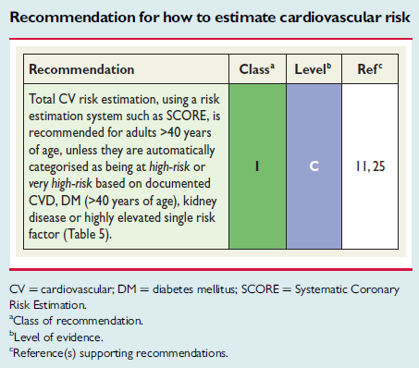
Bedömning
Riskvärdering
Primär/Sekundär prevention
Riskvärdering enligt ESC
Sekundärprevention
BR-2772-11/17SE
Piepoli MF et al, Eur Heart J. 2016. doi:10.1093/eurheartj/ehw106. 2016 European Guidelines on cardiovascular disease prevention in clinical practice

Slide 7
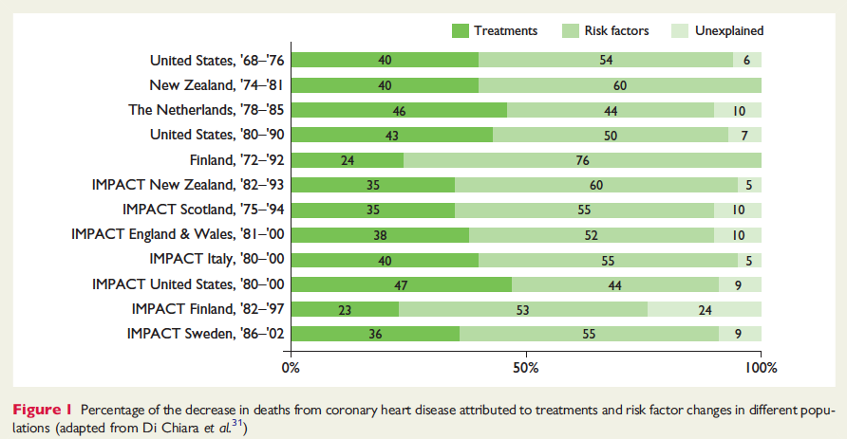
Bedömning
Riskvärdering
Primär/Sekundär prevention
Är riskfaktorpåverkan viktigt?
Sekundärprevention
BR-2772-11/17SE
* Perk J et al, Eur Heart J. 2012 Jul;33(13):1635-1701. 2012 European Guidelines on cardiovascular disease prevention in clinical practice (version 2012).

Slide 8
Bedömning
Riskvärdering
Primär/Sekundär prevention
Varför skilja mellan primär och sekundär prevention?
Sekundärprevention
Vid sekundär prevention gäller:
Högre risknivå
Större absolut effekt av intervention
Större möjlighet att få kliniskt relevant effekt av interventionen
BR-2772-11/17SE

Slide 9
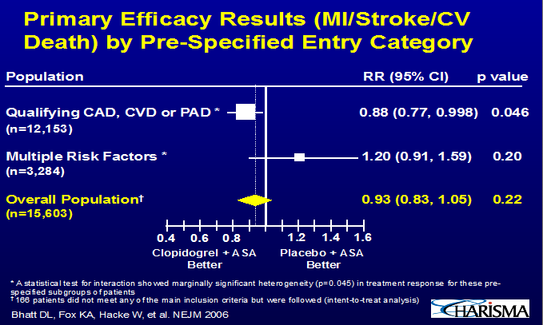
CHARISMA: Kardiovaskulär sjukdom vs riskfaktorer
Bedömning
Sekundärprevention
Riskvärdering
Primär/Sekundär prevention
BR-2772-11/17SE
Bhatt DL et al. N Engl J Med 2006;354:1706-17
Notes:
Tillägg av clopidogrel gav signifikant effekt vid tidigare CVD (sekundär prevention) men inte om pat endast hade ett antal riskfaktorer (primär prevention)

Slide 10
Vad skall bedömas vid sekundär prevention?
Bedömning
Bedömning
Målvärden
Rökning
Fysisk träning
Kolesterol
Blodtryck
Rökning
Fysisk aktivitet
Lipidkontroll
Blodtryckskontroll
Antitrombotisk kontroll
Glykemisk kontroll
Vikt och kost
BR-2772-11/17SE
Socialstyrelsen, Nationella riktlinjer för hjärtsjukvård – stöd för styrning och ledning 2015-10-4

Slide 11
Bedömning
Bedömning
Målvärden
Rökning
Fysisk träning
Kolesterol
Blodtryck
Vilka mål ska vi ha?
Rökstopp efter hjärtinfarkt ≥75% ¹
Fysisk träning: minst 30 min fysisk aktivitet på moderat nivå ≥ 3 ggr (150 min) per vecka ^{1,4}
LDL <1.8 mmol/l alternativt sänkning 50% ²
Blodtryck <140/<90 ²
HbA1c < 53 mmol/mol ⁵
BMI 18.5-24.9; midjemått <89 kvinnor; <102 män ³
Optimal antitrombotisk behandling med hög persistence ⁵
BR-2772-11/17SE
1. Socialstyrelsen, Nationella riktlinjer för hjärtsjukvård – stöd för styrning och ledning 2015-10-4
4. Piepoli MF et al, Eur Heart J. 2016. doi:10.1093/eurheartj/ehw106. 2016 European Guidelines on cardiovascular disease prevention in clinical practice
2. Läkemedelsverket: http://lakemedelsboken.se/
3. AHA/ACC Guidelines; J Am Coll Cardiol. 2014;63(25_PA): doi:10.1016/j.jacc.2013.11.004
5. Bonaca MP et al. Am Heart J 2014;167:437–444, Bonaca MP et al. N Engl J Med 2015;372:1791–1800
Notes:
REF: Socialstyrelsens riktlinjer; Läkemedelsverkets riktlinjer; European soc of cardiology guidelines; AHA/ACCF guidelines

Slide 12
Hur ser evidensen ut - rökning
Bedömning
Bedömning
Målvärden
Rökning
Fysisk träning
Kolesterol
Blodtryck
Vid kranskärlssjukdom ger rökstopp (SoS riktlinjer):
en relativ riskreduktion med 36 procent på mortalitet jämfört med fortsatt rökning (begränsat vetenskapligt underlag)
en relativ riskreduktion med 32 procent på återinsjuknande i hjärtinfarkt jämfört med fortsatt rökning (begränsat vetenskapligt underlag)
BR-2772-11/17SE
Socialstyrelsen, Nationella riktlinjer för hjärtsjukvård – stöd för styrning och ledning 2015-10-4
Notes:
REF: SoS Nat riktlinjer

Slide 13
Bedömning
Bedömning
Målvärden
Rökning
Fysisk träning
Kolesterol
Blodtryck
Hur ser evidensen ut – fysisk träning
Vid kranskärlssjukdom ger fysisk träning:
en relativ riskreduktion med 26 procent på kardiell mortalitet jämfört med sedvanlig behandling (starkt vetenskapligt underlag)
en förbättrad arbetskapacitet med 1,51 METs (högst uppnådd metabolisk ekvivalent) jämfört med sedvanlig behandling (starkt vetenskapligt underlag)
en absolut ökning med 23 procentenheter av benmuskelstyrka jämfört med enbart aerob träning (måttligt starkt vetenskapligt underlag)
en relativ riskreduktion med 31 procent avseende sjukhusinläggning jämfört med sedvanlig behandling (måttligt starkt vetenskapligt underlag)
BR-2772-11/17SE
Socialstyrelsen, Nationella riktlinjer för hjärtsjukvård – stöd för styrning och ledning 2015-10-4
Notes:
REF: SoS Nat riktlinjer

Slide 14
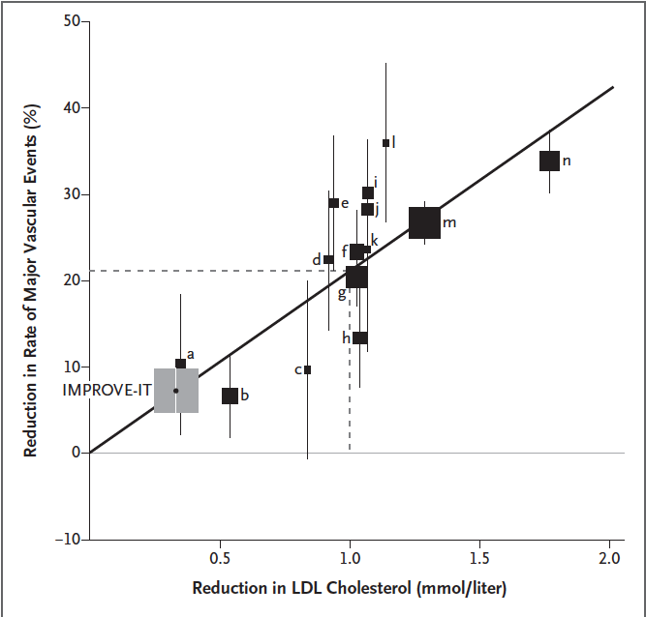
Hur ser evidensen ut - LDL
Bedömning
Bedömning
Målvärden
Rökning
Fysisk träning
Kolesterol
Blodtryck
BR-2772-11/17SE
Cannon CP et al. NEJM 2015; DOI: 10.1056/NEJMoa1410489. IMPROVE-IT
Notes:
REF: IMPROVE IT Cannon et al NEJM 2015; DOI: 10.1056/NEJMoa1410489
Figure 2. Plot of the IMPROVE-IT Trial Data and Statin Trials for Change
in Low-Density Lipoprotein (LDL) Cholesterol versus Clinical Benefit.
The hazard ratio (obtained with the use of a Cox proportional-hazards model)
for the reduction in major vascular events in the simvastatin–ezetimibe
group as compared with the simvastatin-monotherapy group in IMPROVE-IT
is plotted against data from other trials of statins that assessed the association
between change in LDL and clinical benefit. Major vascular events were
defined as a composite of death from coronary heart disease, myocardial
infarction, stroke, or revascularization more than 30 days after randomization.
Vertical bars indicate 1 SE. The size of the box is proportional to the
number of end points in the study. In IMPROVE-IT, the between-group difference
in LDL cholesterol was calculated as the difference in the observed
LDL cholesterol level in patients from whom blood samples were obtained
at 1 year, with imputation of the value measured at the time of randomization
for patients from whom a blood sample was not obtained or was missing
(including those who had died). Letters from a to n denote the following
trials: a: Gruppo Italiano per lo Studio della Sopravvivenza nell’Infarto
Miocardico (GISSI Prevenzione)27; b: Antihypertensive and Lipid-Lowering
Treatment to Prevent Heart Attack Trial–Lipid Lowering Trial (ALLHAT-LLT)28;
c: Assessment of Lescol in Renal Transplantation (ALERT)29; d: Lescol Intervention
Prevention Study (LIPS)30; e: Air Force/Texas Coronary Atherosclerosis
Prevention Study (AFCAPS/TexCAPS)31; f: Cholesterol and Recurrent
Events (CARE)32; g: Long-term Intervention with Pravastatin in Ischaemic
Disease (LIPID)33; h: Prospective Study of Pravastatin in the Elderly at Risk
(PROSPER)34; i: Anglo-Scandinavian Cardiac Outcomes Trial–Lipid Lowering
Arm (ASCOT-LLA)35; j: West of Scotland Coronary Prevention Study
(WOSCOPS)36; k: Post–Coronary Artery Bypass Graft (Post CABG)37; l:
Collaborative
Atorvastatin Diabetes Study (CARDS)38; m: Heart Protection
Study (HPS)2; and n: Scandinavian Simvastatin Survival Study (4S)1.
1. Scandinavian Simvastatin Survival
Study Group. Randomised trial of cholesterol
lowering in 4444 patients with coronary
heart disease: the Scandinavian Simvastatin
Survival Study (4S). Lancet 1994;
344: 1383-9.
2. Heart Protection Study Collaborative
Group. MRC/BHF Heart Protection Study
of cholesterol lowering with simvastatin
in 20,536 high-risk individuals: a randomised
placebo-controlled trial. Lancet 2002;
360: 7-22.
27. GISSI Prevenzione Investigators (Gruppo
Italiano per lo Studio della Sopravvivenza
nell’Infarto Miocardico). Results
of the lowdose (20 mg) pravastatin GISSI
Prevenzione trial in 4271 patients with
recent myocardial infarction: do stopped
trials contribute to overall knowledge?
Ital Heart J 2000; 1: 810-20.
28. ALLHAT Officers and Coordinators
for the ALLHAT Collaborative Research
Group. Major outcomes in moderately hypercholesterolemic,
hypertensive patients
randomized to pravastatin vs usual care:
the Antihypertensive and Lipid-Lowering
Treatment to Prevent Heart Attack Trial
(ALLHAT-LLT). JAMA 2002; 288: 2998-3007.
29. Holdaas H, Fellstr.m B, Jardine AG,
et al. Effect of fluvastatin on cardiac outcomes
in renal transplant recipients: a multicentre,
randomised, placebo-controlled
trial. Lancet 2003; 361: 2024-31.
30. Serruys PW, de Feyter P, Macaya C,
et al. Fluvastatin for prevention of cardiac
events following successful first percutaneous
coronary intervention: a randomized
controlled trial. JAMA 2002; 287:
3215-22.
31. Downs JR, Clearfield M, Weis S, et al.
Primary prevention of acute coronary
events with lovastatin in men and women
with average cholesterol levels: results of
AFCAPS/TexCAPS. Air Force/Texas Coronary
Atherosclerosis Prevention Study.
JAMA 1998; 279: 1615-22.
32. Sacks FM, Pfeffer MA, Moye LA, et al.
The effect of pravastatin on coronary
events after myocardial infarction in patients
with average cholesterol levels.
Cholesterol and Recurrent Events Trial investigators.
N Engl J Med 1996; 335: 1001-9.
33. The Long-Term Intervention with Pravastatin
in Ischaemic Disease (LIPID) Study
Group. Prevention of cardiovascular events
and death with pravastatin in patients
with coronary heart disease and a broad
range of initial cholesterol levels. N Engl J
Med 1998; 339: 1349-57.
34. Shepherd J, Blauw GJ, Murphy MB,
et al. PROspective Study of Pravastatin in
the Elderly at Risk. Pravastatin in elderly
individuals at risk of vascular disease
(PROSPER): a randomised
controlled trial.
Lancet 2002; 360: 1623-30.
35. Sever PS, Dahl.f B, Poulter NR, et al.
Prevention of coronary and stroke events
with atorvastatin in hypertensive patients
who have average or lower-than-average
cholesterol concentrations, in the Anglo-
Scandinavian Cardiac Outcomes Trial —
Lipid Lowering Arm (ASCOT-LLA): a multicentre
randomised
controlled trial.
Lancet 2003; 361: 1149-58.
36. Shepherd J, Cobbe SM, Ford I, et al.
Prevention of coronary heart disease with
pravastatin in men with hypercholesterolemia.
N Engl J Med 1995; 333: 1301-7.
37. Post Coronary Artery Bypass Graft
Trial Investigators. The effect of aggressive
lowering of low-density lipoprotein
cholesterol levels and low-dose anticoagulation
on obstructive changes in saphenous-
vein coronary-artery bypass grafts.
N Engl J Med 1997; 336: 153-62.

Slide 15
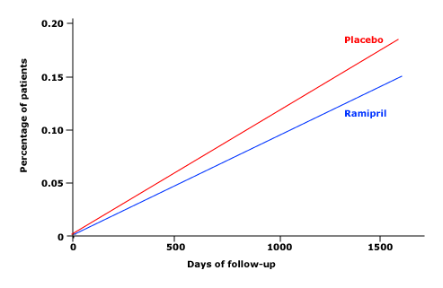
Hur ser evidensen ut – blodtryck
Bedömning
Bedömning
Målvärden
Rökning
Fysisk träning
Kolesterol
Blodtryck
HOPE studien: 4.5 års uppföljning; reduktion av CV död, AMI, stroke 14.1% vs 17.7% ¹
BR-2772-11/17SE
Metaanalys:
Total mortalitet och hjärtinfarkt reduceras med 13.7 resp 13.3 per 1000 behandlade individer med antihypertensiva läkemedel
1. Yusuf S et al, N Engl J Med 2000; 342:145. 2. Thompson AM et al. JAMA 2011;305(9):913-922. doi:10.1001/jama.2011.250
Notes:
The HOPE trial randomized 9541 patients at high risk for a cardiovascular event to ramipril or placebo; after a 4.5 year follow-up, ramipril significantly reduced the incidence of the composite endpoint of death from cardiovascular causes, myocardial infarction, or stroke (14.1 versus 17.7 percent for placebo, relative risk 0.78, p<0.001).
Data from Yusuf, S, Sleight, P, Pogue, J, N Engl J Med 2000; 342:145.
HOPE trial – The HOPE trial evaluated 9297 patients over the age of 55 who were at high risk due to prior cardiovascular disease and/or diabetes mellitus with one other coronary risk factor: At 4.5 years, cardiovascular mortality occurred in 8.1 percent and nonfatal myocardial infarction (MI) in 4.8 percent [10]. The mean BP at entry was 139/79 mmHg. The patients were randomly assigned to ramipril (10 mg once daily) or placebo, given before sleep.
The primary end point was any cardiovascular event (cardiovascular death, MI, or stroke). The trial was prematurely terminated after a 4.5-year follow-up because ramipril therapy was associated with the following significant benefits:
•A reduction in the primary end point (14.0 versus 17.8 percent for placebo, relative risk [RR] 0.78, 95% CI 0.70-0.86) (figure 2) and in each of the individual components of the primary end point, including cardiovascular mortality (6.1 versus 8.1 percent) [10].
•A reduction in nonfatal MI (5.6 versus 7.2 percent) and stroke (3.1 versus 4.5 percent) that was independent of other therapies, including beta blockers, lipid lowering agents, and aspirin
The benefit of ramipril in the HOPE trial was initially thought to be independent of its antihypertensive activity, as the difference between the two groups during the course of the trial was only 3.3/1.4 mmHg (average 135/76 mmHg with ramipril) [15]. However, the actual difference in BP was probably substantially greater. Ramipril was given before bedtime and the office BP was measured about 10 to 18 hours later. In a subset of 38 patients with peripheral artery disease, ambulatory monitoring was performed at baseline and at one year [16]. The 24-hour ambulatory pressure was significantly reduced with ramipril, largely due to a more prominent fall in BP during the night (17/8 mmHg compared to placebo)
Meta-analysis conclusion: Among patients with clinical history of CVD but without hypertension, antihypertensive treatment was associated with decreased risk of stroke, CHF, composite CVD events, and all-cause mortality. Objective To evaluate the effect of antihypertensive treatment on secondary prevention of CVD events and all-cause mortality among persons without clinically defined hypertension

Slide 16
Hur hanteras sekundärprevention i Sverige 2016?
SEPHIA – Rökning
Baseline (28%) resp 1 år (13%)
Bedömning
SEPHIA
Läkemedel
Internationellt
Problem
PEGASUS
NAILED
BR-2772-11/17SE
Figure 6. Proportion of patients who were smokers at baseline and proportion at 2nd follow-up, per hospital with > 10 smokers at baseline and 2nd follow-up 2016.
Swedeheart annual report 2016. Page 133 Figure 6. http://www.ucr.uu.se/swedeheart/index.php/dokument-sh/arsrapporter
Notes:
Figure 7. Proportion of patients who were smokers at baseline (admission to CICU) and at follow-up 12 months post AMI. Patients with 2nd follow-up in 2015.

Slide 17
Bedömning
SEPHIA
Läkemedel
Internationellt
Problem
PEGASUS
NAILED
Hur hanteras sekundärprevention i Sverige 2016?
SEPHIA – Rökning
Rökstopp vid första uppföljningen (61%)
BR-2772-11/17SE
Figure 23. Proportion of patients who have stopped smoking prior to the
1st follow-up, per hospital with > 10 patients and 1st follow-up 2016.
Mean value for 2016, previous years in brackets.
Swedeheart annual report 2016. Figure 23. http://www.ucr.uu.se/swedeheart/index.php/dokument-sh/arsrapporter
Notes:
Figure 25. Proportion of patients who have quit smoking by 1st follow-up 6–10 weeks post AMI. Only participating centres with at least 10 smokers at admission for AMI are included in the figure. Patients with 1st follow-up in 2015, previous years in brackets
REF: SWEDEHEART Årsrapport 2015

Slide 18
Bedömning
SEPHIA
Läkemedel
Internationellt
Problem
PEGASUS
NAILED
Hur hanteras sekundärprevention i Sverige 2016?
SEPHIA – Rökning
Rökstopp vid andra uppföljningen (55 %)
BR-2772-11/17SE
Figure 24. Proportion of patients who have stopped smoking prior to the 2nd follow-up, per hospital with > 10 patients and 2nd follow-up 2016. Quality indicator is based on proportion of patients that have stopped smoking: 0.5 points for ≥ 60 %, 1 point for ≥ 70 %. Mean value for 2016, previous years in brackets.
Swedeheart annual report 2016. Figure 24. http://www.ucr.uu.se/swedeheart/index.php/dokument-sh/arsrapporter
Notes:
Figure 25. Proportion of patients who have quit smoking by 1st follow-up 6–10 weeks post AMI. Only participating centres with at least 10 smokers at admission for AMI are included in the figure. Patients with 1st follow-up in 2015, previous years in brackets
REF: SWEDEHEART Årsrapport 2015

Slide 19
Hur hanteras sekundärprevention i Sverige 2016?
SEPHIA - Fysisk träning
Deltagit i träning första året (52%)
Bedömning
SEPHIA
Läkemedel
Internationellt
Problem
PEGASUS
NAILED
BR-2772-11/17SE
Figure 22. Proportion of patients who have participated in a physical exercise program prior to the 2nd follow-up, per hospital with > 10 patients and 2nd follow-up 2016. Quality indicator point is based on proportion of patients participating: 0.5 points for ≥ 50 %, 1 point for ≥ 60 %. Mean value for 2016, previous years in brackets.
Swedeheart annual report 2016. Page 148 Figure 22 http://www.ucr.uu.se/swedeheart/index.php/dokument-sh/arsrapporter
Notes:
Figure 24. Proportion of patients at each centre, who have participated in a hospital-based physical exercise programme with at least 2 training sessions per week. Patients with 2nd follow-up in 2015, mean value for previous years in brackets.

Slide 20
Hur hanteras sekundärprevention i Sverige 2016?
SEPHIA – Lipider
Medel LDL, Baseline (3.21) resp 1 år (1.90)
Bedömning
SEPHIA
Läkemedel
Internationellt
Problem
PEGASUS
NAILED
BR-2772-11/17SE
Figure 7. Mean LDL-cholesterol level at baseline and at 2nd follow-up, per hospital with > 10 patients at baseline and with 2nd follow-up 2016.
Swedeheart annual report 2016. Page 134 Figure 7. http://www.ucr.uu.se/swedeheart/index.php/dokument-sh/arsrapporter
Notes:
Figure 10. Mean LDL-cholesterol at baseline (admission to CICU) and at follow-up 12 months post AMI at each participating centre. Patients with 2nd follow-up in 2015

Slide 21
Hur hanteras sekundärprevention i Sverige 2016?
SEPHIA - Lipider vid första uppföljningen
LDL <1.8 (60%)
Bedömning
SEPHIA
Läkemedel
Internationellt
Problem
PEGASUS
NAILED
BR-2772-11/17SE
Figure 27. Proportion of patients with LDL-cholesterol < 1,8 mmol/L or apoB
< 0,8 g/L at the 1st follow-up, per hospital with > 10 patients and 1st follow-up 2016. Mean value for 2016, previous years in brackets.
Swedeheart annual report 2016. Page 153 Figure 27. http://www.ucr.uu.se/swedeheart/index.php/dokument-sh/arsrapporter
Notes:
Figure 29. Proportion of patients at each participating centre who have reached treatment target for LDL-cholesterol (LDL < 1.8 mmol/L or a reduction by at least 50 % from baseline, or ApoB < 0.8 g/L) at follow-up 6–10 weeks post AMI. Mean value for 1st follow-up in 2015, previous years in brackets.

Slide 22
Hur hanteras sekundärprevention i Sverige 2016?
SEPHIA - Lipider
LDL <1.8 alt >50% reduktion efter 1 år (59%)
Bedömning
SEPHIA
Läkemedel
Internationellt
Problem
PEGASUS
NAILED
BR-2772-11/17SE
Figure 28. Proportion of patients with LDL-cholesterol at goal < 1,8 mmol/L or apoB < 0,8 g/L at the 2nd follow-up, per hospital with > 10 patients and 1st follow-up 2016. Quality indicator is based on proportion of patients attaining LDL-cholesterol goal: 0.5 points for ≥ 40 %, 1 point for ≥ 60 %. Mean value for 2016, previous years in brackets. Patients with > 50 % reduction in LDL compared with baseline are also included.
Swedeheart annual report 2016. Page 154 Figure 28. http://www.ucr.uu.se/swedeheart/index.php/dokument-sh/arsrapporter
Notes:
Figure 30. Proportion of patients at each participating centre who have reached treatment target for LDL-cholesterol (LDL < 1.8 mmol/L or a reduction by at least 50 % from baseline, or ApoB < 0.8 g/L) at follow-up 12 months post AMI. Mean value for 2nd follow-up in 2015, previous years in brackets.

Slide 23
Hur hanteras sekundärprevention i Sverige 2016?
SEPHIA - Blodtryck
Systoliskt blodtryck <140 mmHg vid 1 år (77%)
Bedömning
SEPHIA
Läkemedel
Internationellt
Problem
PEGASUS
NAILED
BR-2772-11/17SE
Figure 26. Proportion of patients with systolic blood pressure at goal < 140 mmHg at the 2nd follow-up, per hospital with > 10 patients and 1st follow-up 2016. Quality indicator is based on proportion of patients attaining systolic blood pressure goal: 0.5 points for ≥ 70 %, 1 point for ≥ 75 %. Mean value for 2016, previous years in brackets.
Swedeheart annual report 2016. Page 152 Figure 26. http://www.ucr.uu.se/swedeheart/index.php/dokument-sh/arsrapporter
Notes:
Figure 28. Proportion of patients at each participating centre who have reached treatment target for systolic blood pressure, < 140 mmHg, at follow-up 12 months post AMI. Mean value for 2nd follow-up in 2015, previous years in brackets.

Slide 24
Hur hanteras sekundärprevention i Sverige 2016?
SEPHIA – Sammanfattning (Q4)
Uppnått alla mål för lipider, systoliskt BT, rökstopp och fysiskt träningsprogram efter ett år (26%)
Bedömning
SEPHIA
Läkemedel
Internationellt
Problem
PEGASUS
NAILED
BR-2772-11/17SE
Figure 30. Proportion of patients reaching 4 out of 4 prevention goals (Q4): systolic blood pressure < 140 mmHg, LDL-cholesterol < 1.8 mmol/L (or > 50 % reduction from baseline, or apoB
< 0.8 g/L) , abstinence from daily smoking, and participation in a physical exercise program, at 2nd follow-up post AMI, per hospital with > 10 patients, where > 50 % of patients in 2016 had complete data for Q4, and 2nd follow-up 2016. Mean value for 2016, previous years in brackets.
Swedeheart annual report 2016. Page 156 Figure 30. http://www.ucr.uu.se/swedeheart/index.php/dokument-sh/arsrapporter
Notes:
Figure 32. Proportion of patients reaching 4 out of 4 prevention goals (Q4): systolic blood pressure < 140 mmHg, LDL-cholesterol < 1.8 mmol/L (or > 50 % reduction from baseline, or ApoB < 0.8 g/L), abstinence from daily smoking, and participation in a physical exercise programme, at follow-up 12 months post AMI. Hospitals included in this figure had at least 50 % patients with complete data for Q4. Patients with 2nd follow-up in 2015, previous years in brackets.

Slide 25
Bedömning
SEPHIA
Läkemedel
Internationellt
Problem
PEGASUS
NAILED
SEPHIA - begränsningar
Patienter under 75 år (f.o.m 2018 80 år)
Inkluderade 2015: 7155. Ej inkluderade: 2384. Ej inkluderade har i större utsträckning tidigare kardiovaskulär sjukdom och fler riskfaktorer.
Bortfall 20% vid första uppföljningen (pers.com).
Uppföljning 1 år; vad händer sedan?
BR-2772-11/17SE
Swedeheart annual report 2016. http://www.ucr.uu.se/swedeheart/index.php/dokument-sh/arsrapporter

Slide 26
Bedömning
SEPHIA
Läkemedel
Internationellt
Problem
PEGASUS
NAILED
Internationell utblick
EUROASPIRE; rapport IV februari 2015
< 80 år
Intervju 6 mån – 3 år efter händelsen (median 1.35 år)
CABG; PCI; AMI; UA (diagnoskod I20)
16426 journalgranskningar varav 7998 intervjuades inkl. provtagning
Saknade data data vid utskrivning; blodtryck 13%; rökning 26%
BR-2772-11/17SE
Kotseva et al. Eur J of Prev Card 2015; DOI: 10.1177/2047487315569401 : A European Society of Cardiology survey on the lifestyle, risk factor and therapeutic management of coronary patients from 24 European Countries. EUROASPIRE IV
Notes:
EUROASPIRE IV Kotseva et al. European Journal of Preventive Cardiology 2015; DOI: 10.1177/2047487315569401 : A European Society of
Cardiology survey on the lifestyle, risk
factor and therapeutic management of
coronary patients from 24 European
Countries
REF: SWEDEHEART Årsrapport 2015

Slide 27
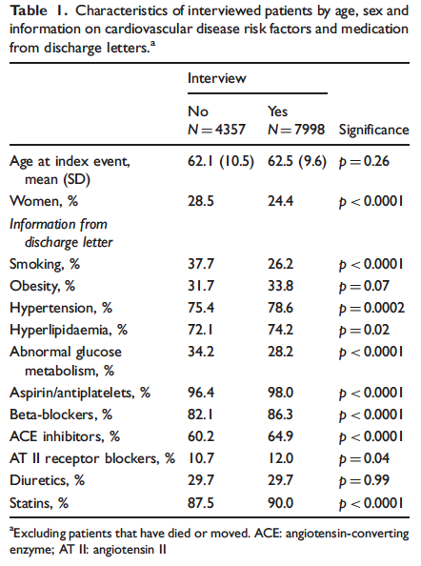
Bedömning
SEPHIA
Läkemedel
Internationellt
Problem
PEGASUS
NAILED
EUROASPIRE IV - Patientkarakteristika
48.7 % av granskade fall intervjuades
BR-2772-11/17SE
Kotseva et al. Eur J of Prev Card 2015; DOI: 10.1177/2047487315569401 : A European Society of Cardiology survey on the lifestyle, risk factor and therapeutic management of coronary patients from 24 European Countries. EUROASPIRE IV
Notes:
EUROASPIRE IV Kotseva et al. European Journal of Preventive Cardiology 2015; DOI: 10.1177/2047487315569401 : A European Society of
Cardiology survey on the lifestyle, risk
factor and therapeutic management of
coronary patients from 24 European
Countries
REF: SWEDEHEART Årsrapport 2015

Slide 28
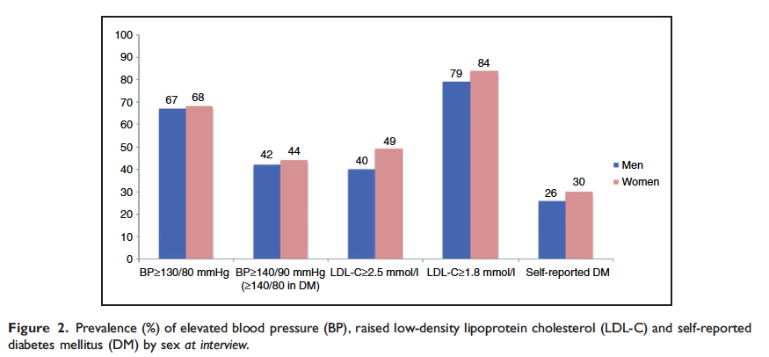
Bedömning
SEPHIA
Läkemedel
Internationellt
Problem
PEGASUS
NAILED
EUROASPIRE IV: Förekomst av riskfaktorer
BR-2772-11/17SE
Kotseva et al. Eur J of Prev Card 2015; DOI: 10.1177/2047487315569401 : A European Society of Cardiology survey on the lifestyle, risk factor and therapeutic management of coronary patients from 24 European Countries. EUROASPIRE IV
Notes:
EUROASPIRE IV Kotseva et al. European Journal of Preventive Cardiology 2015; DOI: 10.1177/2047487315569401 : A European Society of
Cardiology survey on the lifestyle, risk
factor and therapeutic management of
coronary patients from 24 European
Countries
REF: SWEDEHEART Årsrapport 2015

Slide 29
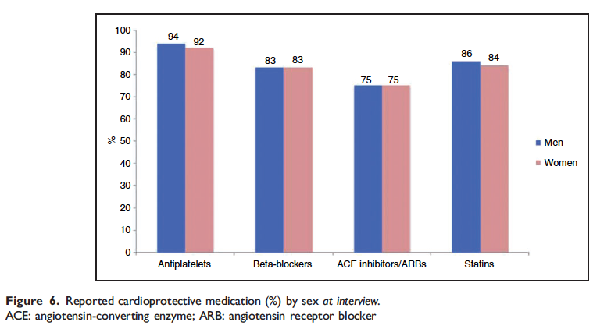
Bedömning
SEPHIA
Läkemedel
Internationellt
Problem
PEGASUS
NAILED
EUROASPIRE IV: Läkemedelsanvändning
- jämför med riskfaktorförekomst
BR-2772-11/17SE
Kotseva et al. Eur J of Prev Card 2015; DOI: 10.1177/2047487315569401 : A European Society of Cardiology survey on the lifestyle, risk factor and therapeutic management of coronary patients from 24 European Countries. EUROASPIRE IV
Notes:
EUROASPIRE IV Kotseva et al. European Journal of Preventive Cardiology 2015; DOI: 10.1177/2047487315569401 : A European Society of
Cardiology survey on the lifestyle, risk
factor and therapeutic management of
coronary patients from 24 European
Countries
REF: SWEDEHEART Årsrapport 2015

Slide 30
Bedömning
SEPHIA
Läkemedel
Internationellt
Problem
PEGASUS
NAILED
Vilka är då problemen?
Övervikt svår att påverka (SEPHIA m.fl.)
Rökstopp – andel väsentligen oförändrad över tid (SEPHIA)
De med högst risk inkluderas inte
Åldersdiskriminering
Inkompletta data
Bortfall under uppföljning
Kort uppföljning
Riskfaktormål uppnås inte trots hög användning av läkemedel
BR-2772-11/17SE
Notes:
EUROASPIRE IV Kotseva et al. European Journal of Preventive Cardiology 2015; DOI: 10.1177/2047487315569401 : A European Society of
Cardiology survey on the lifestyle, risk
factor and therapeutic management of
coronary patients from 24 European
Countries
REF: SWEDEHEART Årsrapport 2015

Slide 31
Bedömning
SEPHIA
Läkemedel
Internationellt
Problem
PEGASUS
NAILED
Bortfall vid långtidsuppföljning – exemplet IMPROVE-IT
Simvastatin vs simvastatin + ezetimibe
Randomiserade: 9077 vs 9067
Medianuppföljning 6 år
Av de som fullföljde final visit (6860 vs 6868) var aktuell andel på studiedrog 61% vs 63% (4168 vs 4294)
BR-2772-11/17SE
Cannon et al. N Eng J Med 2015; DOI: 10.1056/NEJMoa1410489. IMPROVE-IT

Slide 32
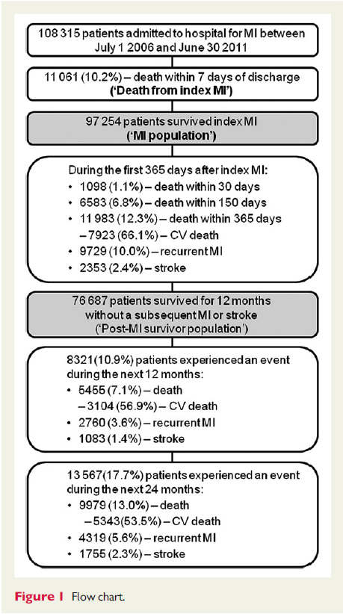
Bedömning
SEPHIA
Läkemedel
Internationellt
Problem
PEGASUS
NAILED
Utfall på lång sikt– exemplet HELICON
APOLLO-HELICON är en retrospektiv cohort-studie som analyserar data från tre svenska register: Diagnosregistret, Läkemedelsregistret och Dödsfallsregistret
Individuell patientdata från dessa register där personnummer användes för att samla data från de tre registerna. Sedan ersattes personnummer med en personlig nummerkod för att användas I studiens dataanalyser
Primär komposit endpoint bestod av:
  Icke-fatal Hjärtinfarkt(ICD-10: I21)
  Icke-fatal Stroke (ICD-10: I61–I64), eller
  Kardiovaskulär död (alla primära orsaker till död diagnosticerade med ICD-10 koder I00–I99).
BR-2772-11/17SE
Jernberg T et al. Eur Heart J 2015: doi:10.1093/eurheartj/ehu505

Slide 33
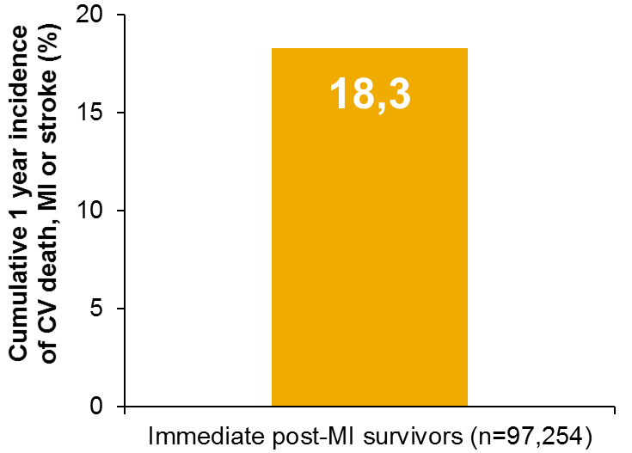
Resultat: kardiovaskulär död, hjärtinfarkt eller stroke inom 365 dagar från ursprunglig hjärtinfarkt
Bedömning
SEPHIA
Läkemedel
Internationellt
Problem
PEGASUS
NAILED
Utfall på lång sikt– exemplet HELICON
BR-2772-11/17SE
~1 av 5 patienter drabbades av en hjärtinfarkt, stroke eller kardiovaskulär död under det första året efter hjärtinfarkt
CV, cardiovascular; MI, myocardial infarction.
Jernberg T et al. Eur Heart J 2015: doi:10.1093/eurheartj/ehu505

Slide 34
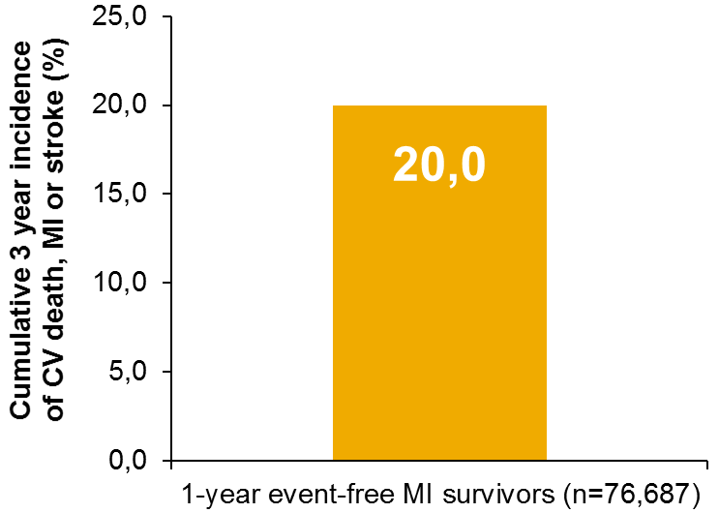
Bedömning
SEPHIA
Läkemedel
Internationellt
Problem
PEGASUS
NAILED
Utfall på lång sikt– exemplet HELICON
Resultat: kardiovaskulär död, hjärtinfarkt eller stroke i gruppen som överlevt första året efter hjärtinfarkt
BR-2772-11/17SE
~1 av 5 patienter fria från event under första året efter hjärtinfarkt, drabbades av en ny hjärtinfarkt, stroke eller kardiovaskulär död under de kommande tre åren
CV, cardiovascular; MI, myocardial infarction.
Jernberg T et al. Eur Heart J 2015: doi:10.1093/eurheartj/ehu505
Notes:
Av de 20% av patienterna som fick en hjärt-kärlhändelse under tre års uppföljning fick 40.8% hjärtinfarkt, 18.6% Stroke och 40.6% dog av kardiovaskulära orsaker .
Uppföljningen var i medeltal 2.54 år och maximal uppföljning var 5.5 år.

Slide 35
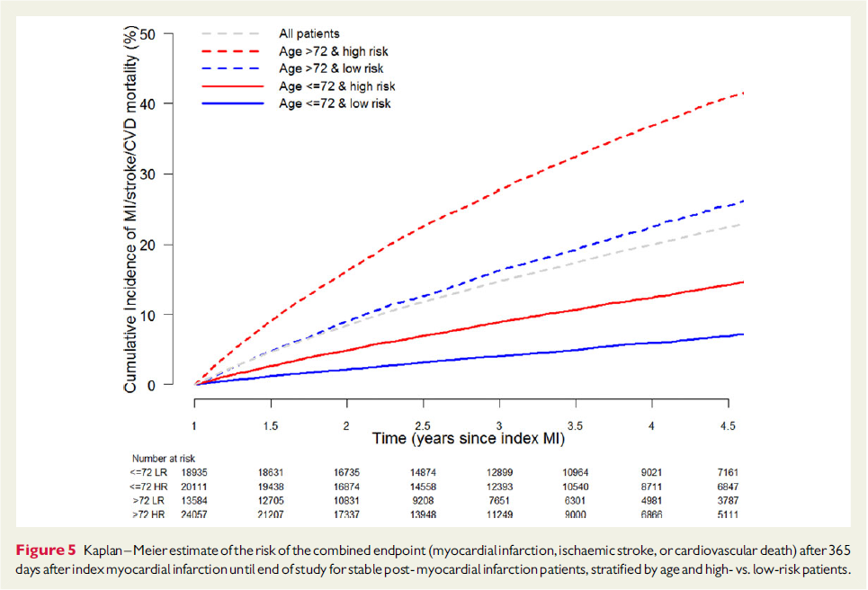
Risk för komposit endpoint (kardiovaskulär död, hjärtinfarkt eller stroke) 365 dagar efter indexerad hjärtinfarkt och fram till studieslut
Bedömning
SEPHIA
Läkemedel
Internationellt
Problem
PEGASUS
NAILED
Utfall på lång sikt– exemplet HELICON
BR-2772-11/17SE
Jernberg T et al. Eur Heart J 2015: doi:10.1093/eurheartj/ehu505

Slide 36
PEGASUS-TIMI 54:
Bedömning
SEPHIA
Läkemedel
Internationellt
Problem
PEGASUS
NAILED
Studiedesign
Inklusionskriterier
Patienter ≥50 år med tidigare genomgången hjärtinfarkt 1–3 år före studiestart OCH minst en ytterligare atherotrombotisk riskfaktor*
(N=21,162)
Ålder ≥50 år
Genomgången hjärtinfarkt 1–3 år före inklusion och ytterligare en högriskfaktor:
  Ålder ≥65 år
  Diabetes mellitus som kräver medicinering
  Två tidigare hjärtinfarkter
  Angiografiskt verifierad flerkärlsjuka
  Kronisk, icke-dialysberoende njursjukdom (CrCl <60 mL/min)
Recept på ASA och tolererar acetylsalicylsyra vid inclusion i studien
BR-2772-11/17SE
Tikagrelor 90 mg 1x2
+ ASA 75–150 mg/day
Tikagrelor 60 mg 1x2
+ ASA 75–150 mg/day
Placebo
+ ASA 75–150 mg/day
Minst 12 månaders uppföljning:
Var 4:e månad under år 1,
därefter var 6:e månad
Primärt effektmått: Kardiovaskulär död, Hjärtinfarkt eller stroke
Primärt säkerhetsmått: TIMI-definerad allvarlig blödning
*Ålder ≥65 år, diabetes mellitus, två tidigare hjärtinfarkter, flerkärlssjuk enligt angiografi eller kronisk njursjukdom
TIMI, Thrombolysis in Myocardial Infarction
Bonaca MP et al. Am Heart J 2014;167:437–444. Bonaca MP et al. N Engl J Med 2015;372:1791–1800
Notes:
PEGASUS-TIMI 54:
Major Exclusion Criteria
Planned use of a P2Y₁₂ receptor antagonist, dipyridamole, cilostazol, or anticoagulant therapy during the study period
Bleeding disorder, history of ischaemic stroke or intracranial bleeding, central nervous system tumour or intracranial vascular abnormality
Gastrointestinal bleeding within the previous 6 months or major surgery within the previous 30 days
High risk of bradycardic events
Severe hepatic or renal disease

Slide 37
PEGASUS-TIMI 54: Primärt effektmått
Bedömning
SEPHIA
Läkemedel
Internationellt
Problem
PEGASUS
NAILED
10
Placebo
Tikagrelor 90 mg 1x2
Tikagrelor 60 mg 1x2
Primärt effektmått
  Komposit sammansatt av kardiovaskulär död, hjärtinfarkt eller stroke
Sekundära effektmått
  Kardiovaskulär mortalitet
  Total mortalitet
Andra specificerade explorerande effektmått
  Komposit sammansättning av död i hjärtsjukdom, hjärtinfarkt eller stroke
  Individuella komponenter av komposit effektmått
  Akut revaskularisering
  Sjukhusinläggning för instabil angina
  Övergående ischemisk attack (TIA)
  Analyser av klinisk nytta (netto)
9
9.04% Placebo
8
7.85% 90 mg 1x2
BR-2772-11/17SE
7
7.77% 60 mg 1x2
6
5
Event rate (%)
4
3
Tikagrelor 90 mg vs placebo
HR 0.85 (95% CI 0.75–0.96) P=0.008
2
Tikagrelor 60 mg vs placebo
HR 0.84 (95% CI 0.74–0.95) P=0.004
1
0
0
3
6
9
12
15
18
21
24
27
30
33
36
No. at risk
Placebo
90 mg bid
60 mg bid
Months from randomisation
7067
7050
7045
6979
6973
6969
6892
6899
6905
6823
6827
6842
6761
6769
6784
6681
6719
6733
6508
6550
6557
6236
6272
6270
5876
5921
5904
5157
5243
5222
4343
4401
4424
3360
3368
3392
2028
2038
2055
P<0.026 indikerar statistisk signifikans; CI, confidence interval; HR, hazard ratio
Bonaca MP et al. N Engl J Med 2015;372:1791–1800

Slide 38
Reduktion av kardiovaskulär död, hjärtinfarkt eller stroke med tikagrelor med hänsyn till tidigare behandlingsstopp av P2Y₁₂ -hämmare
Bedömning
SEPHIA
Läkemedel
Internationellt
Problem
PEGASUS
NAILED
Time from P2Y₁₂ inhibitor withdrawal to randomization
HR (95% CI)
P value
BR-2772-11/17SE
0.70 (0.57, 0.87)
0.75 (0.61, 0.92)
0.73 (0.61, 0.87) <0.001
0.90 (0.72, 1.12)
0.82 (0.65, 1.02)
0.86 (0.71, 1.04) 0.11
0.96 (0.73, 1.26)
1.06 (0.81, 1.38)
1.01 (0.80, 1.27) 0.96
≤30 days
n=7181
27% RRR
>30 days
to 1 year
n=6501
14% RRR
Ticagrelor 90 mg
>1 year
n=5079
Ticagrelor 60 mg
∅ RRR
Pooled
0.7
0.9
1.1
Ticagrelor better
1.0
Placebo better
Bonaca MP et al. Eur Heart J 2015. doi:10.1093/eurheartj/ehv531. Figure 2

Slide 39
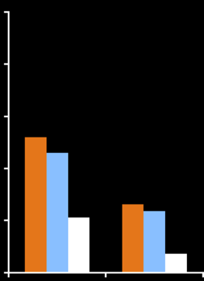
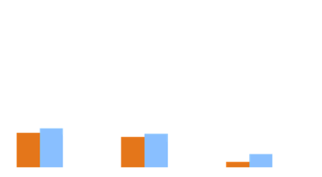
PEGASUS-TIMI 54: Blödningar
Bedömning
SEPHIA
Läkemedel
Internationellt
Problem
PEGASUS
NAILED
5
4
Tikagrelor 90 mg bid
Tikagrelor 60 mg bid
Placebo
BR-2772-11/17SE
P<0.001
3
2.6
2.3
3-year KM event rate
2
P<0.001
P=NS
P=NS
P=NS
1.3
1.2
1.1
1
0.7
0.6
0.6
0.6
0.6
0.5
0.4
0.3
0.3
0.1
0
TIMI major bleeding
TIMI minor bleeding
Fatal bleeding or ICH
ICH
Fatal bleeding
Rates are presented as 3-year Kaplan-Meier estimates
Bonaca MP et al. N Engl J Med 2015;372:1791–1800

Slide 40
Bedömning
SEPHIA
Läkemedel
Internationellt
Problem
PEGASUS
NAILED
PEGASUS-TIMI 54 – EU label population
Patienter ≤2 år från index MI eller ≤1 år från avslutad ADP-receptorhämmarbehandling (efficacy cohort)
Outcome Efficacy | Tikagrelor 60 mg bid N=5388 |  | Placebo N=5391 |  | Hazard ratio (95% CI) | P value
 | n | 3 year KM% | n | 3 year KM%
Composite of CV death, MI or stroke | 373 | 7.9 | 463 | 9.6 | 0.80 (0.70–0.91) | 0.001
CV death | 119 | 2.6 | 167 | 3.6 | 0.71 (0.56–0.90) | 0.0041
MI | 230 | 4.8 | 274 | 5.6 | 0.83 (0.70–0.99) | 0.041
Stroke | 71 | 1.5 | 95 | 2.0 | 0.74 (0.55–1.01) | 0.058
All-cause mortality | 206 | 4.4 | 256 | 5.4 | 0.80 (0.67–0.96) | 0.018
BR-2772-11/17SE
Outcome Safety | Tikagrelor 60 mg bid N=5322 |  | Placebo N=5331 |  | Hazard ratio (95% CI) | P value
 | n | 3 year KM% | n | 3 year KM%
TIMI major bleeding | 94 | 2.5 | 43 | 1.1 | 2.36 (1.65–3.39) | <0.0001
Fatal or intracranial bleeding | 27 | 0.8 | 25 | 0.7 | 1.17 (0.68–2.01) | 0.58
Ref: Dellborg M et al. Presented at ESC congress 27 August 2017, Barcelona, P3670

Slide 41
Bedömning
SEPHIA
Läkemedel
Internationellt
Problem
PEGASUS
NAILED
Konklusion
Behandlingsstopp av P2Y12-hämmare förefaller ge en ökad långtidsrisk för aterotrombotiska händelser i en population av patienter med förhöjd risk för nya händelser
Större försiktighet bör användas innan behandling med dubbel trombocythämning avslutas hos hjärtinfarktpatienter med hög risk
Nyttan med tikagrelor är definierad hos högriskpatienter med ett behandlingsavbrott på upp till 30 dagar från tidigare P2Y12-hämmarbehanling
Dessa data stärker fortsatt dubbel trombocythämning med tikagrelor plus asa bortom år 1 efter hjärtinfarkt hos högrisk hjärtinfarktspatienter, för att reducera risken för aterotrombotiska händelser
Kliniker bör sammanväga både ischemisk- och blödningsrisk vid val av lämpliga patienter, för längre behandling med tikagrelor och asa. Detta för att hitta de patienter som har störst klinisk nytta av förlängd terapi.
BR-2772-11/17SE
Bonaca MP et al. Eur Heart J 2015:doi:10.1093/eurheartj/ehv531

Slide 42
NAILED - metod
Bedömning
SEPHIA
Läkemedel
Internationellt
Problem
PEGASUS
NAILED
BR-2772-11/17SE
Mooe T, Bergström L, Irewall A-L, Ögren J. The NAILED stroke risk factor trial (Nurse based Age independent Intervention to Limit Evolution of Disease after stroke): study protocol for a randomized controlled trial. Trials 2013; 14:5.
Mooe T, Björklund F, Graipe, A, Huber D, Jakobsson S, Kajermo U, Strömvall A, Ulvenstam A. The NAILED ACS risk factor trial (Nurse based Age independent Intervention to Limit Evolution of Disease after Acute Coronary Syndrome): study protocol for a randomized controlled trial. JMIR Res Protoc 2014:3:e42.
Notes:
REF: Mooe T, Bergström L, Irewall A-L, Ögren J. The NAILED stroke risk factor trial (Nurse based Age independent Intervention to Limit Evolution of Disease after stroke): study protocol for a randomized controlled trial. Trials 2013; 14:5.
Mooe T, Björklund F, Graipe, A, Huber D, Jakobsson S, Kajermo U, Strömvall A, Ulvenstam A. The NAILED ACS risk factor trial (Nurse based Age independent Intervention to Limit Evolution of Disease after Acute Coronary Syndrome): study protocol for a randomized controlled trial. JMIR Res Protoc 2014:3:e42.

Slide 43
NAILED - metod
Bedömning
SEPHIA
Läkemedel
Internationellt
Problem
PEGASUS
NAILED
Inklusion majoritet av AKS patienter och därmed högre risk
961 patients screened
54 dead in-hospital
NAILED ACS studien
(Nurse based Age independent Intervention to Limit Evolution of Disease)
BR-2772-11/17SE
907 patients for initial assessment
661 (72.9%) included and randomized
100 (11%) declined participation
146 (16.1%) excluded
43 in other trial
37 dementia
35 other advanced disease
14 deafness
7 advanced heart disease
6 advanced stroke disease
1 aphasia
3 other reason
Figure 1. Study flow chart.
Huber D , Henriksson R, Jakobsson S, Stenfors N, Mooe T. Telemedical secondary preventive intervention after acute coronary syndrome: Implementation and one-­year survival. BMC Trials 2016;17:85. DOI 10.1186/s13063-­016-­1203-­x
Notes:
NAILED ACS studien. Av alla ACS patienter som vårdades på sjukhus kunde 73% inkluderas för vidare uppföljning (78% om de som inkluderades i andra studier räknas in). Medelålder: inkluded 69.2; excluded 76.3; declined 77.3.

Slide 44
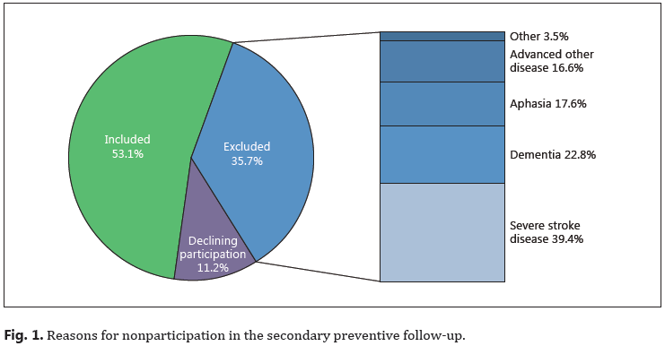
NAILED - metod
Bedömning
SEPHIA
Läkemedel
Internationellt
Problem
PEGASUS
NAILED
Inklusion majoritet av Stroke/TIA patienter och därmed högre risk
NAILED Stroke/TIA studien (Nurse based Age independent Intervention to Limit Evolution of Disease)
BR-2772-11/17SE
Irewall AL, Bergström L, Ögren J, Laurell K, Söderström L, Mooe T. Implementation of telephone-based secondary preventive intervention after stroke and transient ischemic attack – participation rate, reasons for nonparticipation and one-year mortality. Cerebrovasc Dis Extra 2014;4:28-39.
Notes:
Medelålder; inkluderade 71.8; exkluderade 81.5; declined 77.2
Irewall AL, Bergström L, Ögren J, Laurell K, Söderström L, Mooe T. Implementation of telephone-based secondary preventive intervention after stroke and transient ischemic attack – participation rate, reasons for nonparticipation and one-year mortality. Cerebrovasc Dis Extra 2014;4:28-39.

Slide 45
Bedömning
SEPHIA
Läkemedel
Internationellt
Problem
PEGASUS
NAILED
Andel som följdes upp i NAILED Stroke/TIA vid ett år
Uppföljning avseende lipider och blodtryck
Intervention n=266; kontroll n=271
Död eller bortfall: 24 vs 25
Uppföljning vid ett år (lipider+blodtryck) av överlevande/ej bortfall: 241/242 (1 pat utan lab data) vs 243/246 (3 patienter orkade inte fullfölja uppföljningen)
Resultat för patienter som låg över målvärde för blodtryck respektive LDL vid studiestart:
Systoliskt blodtryck var 8 mmHg lägre i interventionsgruppen jämfört
med kontrollgruppen (95% konfidensintervall 4.0-­12.1)
LDL var 0.6 mmol lägre i interventionsgruppen jämfört med kontrollgruppen (95% konfidensintervall 0.4-­0.9)
BR-2772-11/17SE
NAILED Stroke/TIA studien (Nurse based Age independent Intervention to Limit Evolution of Disease)
Irewall A-L, Ögren J, Bergström L, Laurell K, Söderström L, Mooe T. Nurse-led, telephone-based, secondary preventive follow-up after stroke or transient ischemic attack improves blood pressure and LDL cholesterol: Results from the first 12 months of the randomized, controlled NAILED stroke risk factor trial. PloS ONE 2015;10:e0139997
Notes:
Irewall A-L, Ögren J, Bergström L, Laurell K, Söderström L, Mooe T. Nurse-led, telephone-based, secondary preventive follow-up after stroke or transient ischemic attack improves blood pressure and LDL cholesterol: Results from the first 12 months of the randomized, controlled NAILED stroke risk factor trial. PloS ONE 2015;10:e0139997

Slide 46
Varför nås inte målvärden?
NAILED ACS diabetiker
Bedömning
SEPHIA
Läkemedel
Internationellt
Problem
PEGASUS
NAILED
BR-2772-11/17SE
NAILED ACS studien
(Nurse based Age independent Intervention to Limit Evolution of Disease)
Jakobsson S, Huber D, Björklund F, Mooe T. Implementation of a new guideline in cardiovascular secondary preventive care: subanalysis of a randomized controlled trial. BMC Cardiovascular Disorders 2016;;16:77 DOI 10.1186/s12872-­016-­0252-­0
Notes:
Kardiovaskulärt Vårmöte 2015: Jakobsson S, Huber D, Björklund F, Mooe T. Implementation of a new guideline in cardiovascular secondary preventive care: subanalysis of a randomized controlled trial.

Slide 47
Slutsats NAILED - Vad behövs??
Bedömning
SEPHIA
Läkemedel
Internationellt
Problem
PEGASUS
NAILED
Oselekterad inklusion
Kompletta data
Hög uthållighet
Långtidsuppföljning
Effektiv läkemedelsanvändning
Effektivare läkemedel (lipidkontroll)
BR-2772-11/17SE

Slide 48
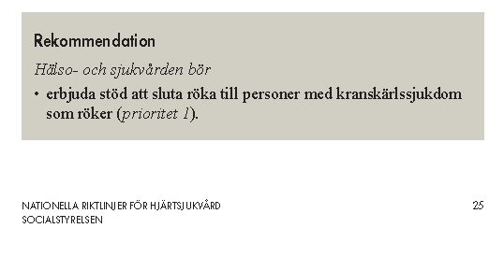
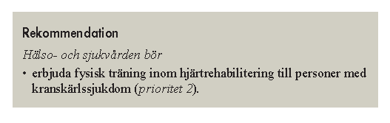
Socialstyrelsen om rökstopp och fysisk aktivitet
Bedömning
Nationella
Internationella
Regionala
BR-2772-11/17SE
Socialstyrelsen, Nationella riktlinjer för hjärtsjukvård – stöd för styrning och ledning 2015-10-4
Notes:
Sida 5
48

Slide 49
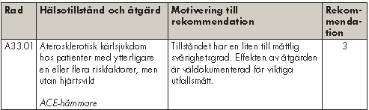
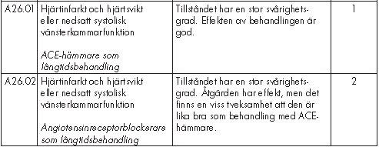
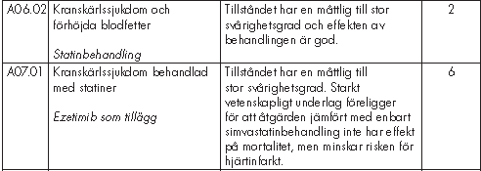
Socialstyrelsen om sekundärprevention
Bedömning
Nationella
Internationella
Regionala
BR-2772-11/17SE
Socialstyrelsen, Nationella riktlinjer för hjärtsjukvård – stöd för styrning och ledning 2015-10-4
Notes:
Sida 5
49

Slide 50
Bedömning
Nationella
Internationella
Regionala
Riskvärdering enligt ESC
BR-2772-11/17SE
Piepoli MF et al, Eur Heart J. 2016. doi:10.1093/eurheartj/ehw106. 2016 European Guidelines on cardiovascular disease prevention in clinical practice
Notes:
Sida 5
50

Slide 51
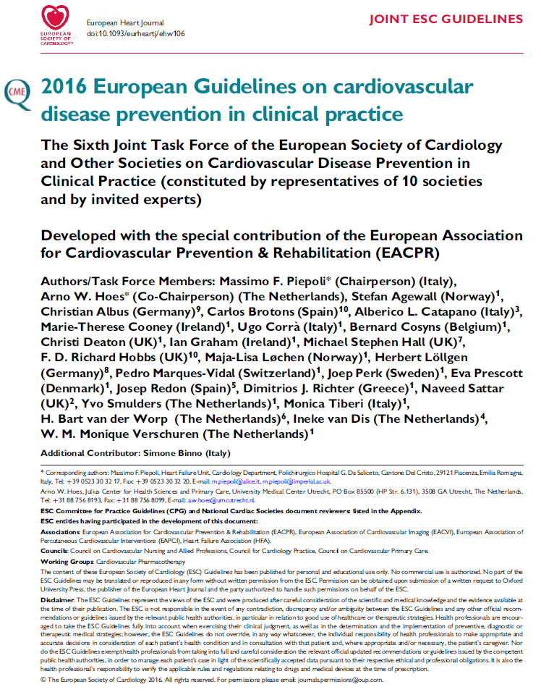
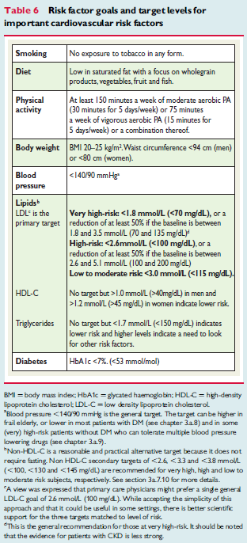
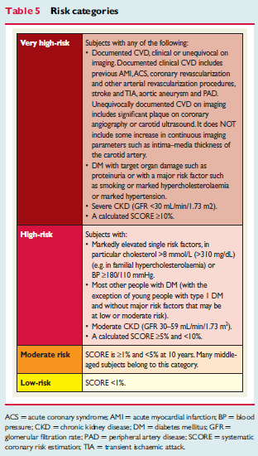
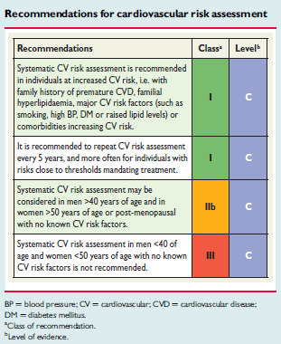
Bedömning
Nationella
Internationella
Regionala
BR-2772-11/17SE
Piepoli MF et al, Eur Heart J. 2016. doi:10.1093/eurheartj/ehw106. 2016 European Guidelines on cardiovascular disease prevention in clinical practice
Notes:
Sida 5
51

Slide 52
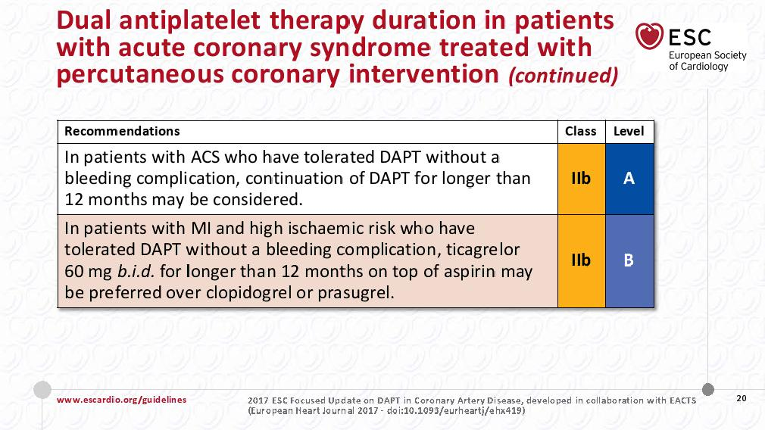
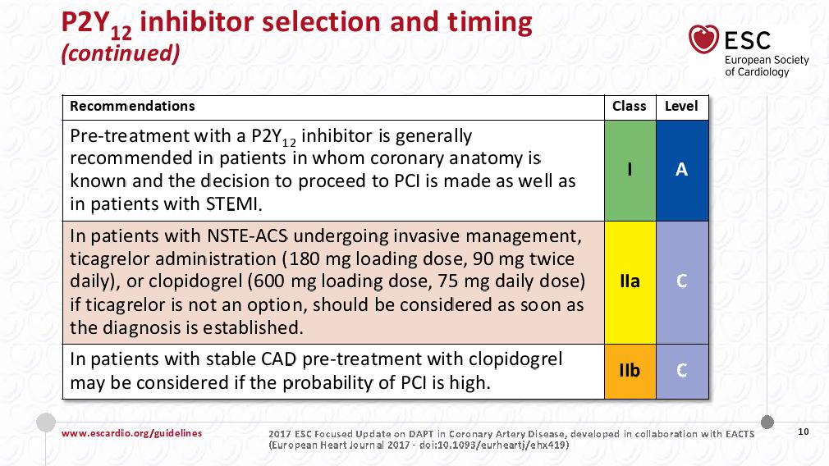
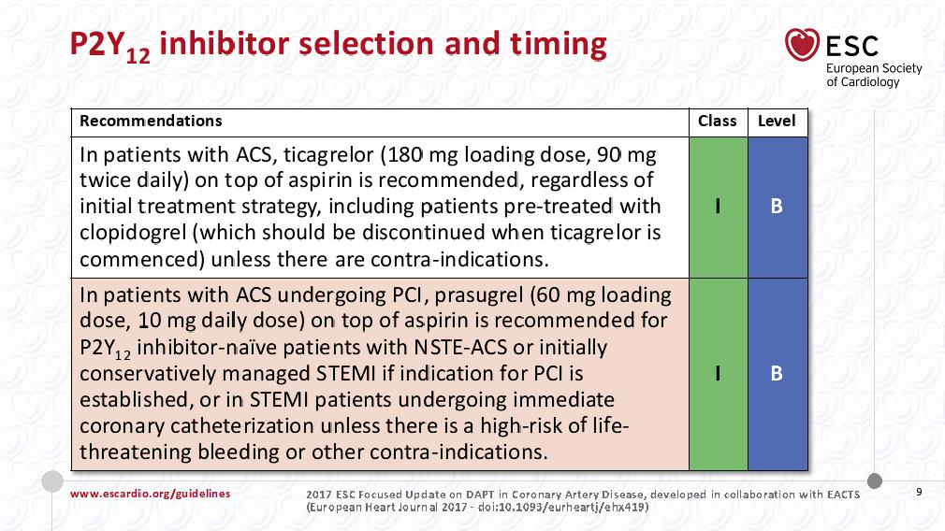
Bedömning
Nationella
Internationella
Regionala
ESC DAPT Guidelines 2017
Initial- och långsiktig antitrombotisk behandling
BR-2772-11/17SE
Valgimigli M et al. European Heart Journal (2017) 0, 1–48, doi:10.1093/eurheartj/ehx419. 2017 ESC focused update on dual antiplatelet therapy in coronary artery disease
Notes:
Sida 5
52

Slide 53
Lokala riktlinjer / PM
Bedömning
Nationella
Internationella
Regionala
BR-2772-11/17SE
Notes:
Sida 5
53

Slide 54
Lokala riktlinjer / PM
Bedömning
Nationella
Internationella
Regionala
BR-2772-11/17SE
Notes:
Sida 5
54

Slide 55
Lokala riktlinjer / PM
Bedömning
Nationella
Internationella
Regionala
BR-2772-11/17SE
Notes:
Sida 5
55

Slide 56
Lokala riktlinjer / PM
Bedömning
Nationella
Internationella
Regionala
BR-2772-11/17SE
Notes:
Sida 5
56

Slide 57
Adam, 72 år
Bedömning
Adam
Eva
Man 72 år. Inkommer med bröstsmärta.
Hereditet: far hjärtinfarkt före 55 år. Diabetes. Alzheimer.
Socialt: Exrökare, 2 paketår. Snusar.
Tidigare sjukdomar: Hypertoni. Totalplastik höft 6 mån innan, infektionsproblem, Targocid-behandling.
Aktuellt: Bröstsmärta i perioder senaste dygnet, ihållande flera timmar innan ambulans tillkallas. Lättar bra på nitro.
Status: opåverkad, inga svikttecken, saturation 98%, hjärtfrekvens 83, blodtryck 137/87. BMI 33. Vikt 103 kg.
EKG: lätta ST-T förändringar lateralt talande för ischemi.
LAB: Hb 132, CRP 2.2, hsTnT 527, s-glukos 7.8. Lipidstatus nästa morgon: kolesterol 4.4, LDL 2.9, HDL 0.81, TG 1.6.
BR-2772-11/17SE
Notes:
57

Slide 58
Bedömning
Adam
Eva
Adam, 72 år
Bedöms som NSTEMI. Behandlas med ASA, Ticagrelor, Fondaparinux, Metoprolol.
Koronarangio: tät LCX stenos. Stentas, BMS.
Utskrivningsläkemedel: Seloken ZOC 50mg, Losartan 50mg, Trombyl 75mg, Brilique 90mg 1x2 i 12 mån, Simvastatin 20mg.
BR-2772-11/17SE
Notes:
58

Slide 59
Adam, 72 år. Uppföljning 1 månad
Bedömning
Adam
Eva
BT sitt 125/85, stående 130/90
Kolesterol 4.2, LDL 2.4
Ökas Losartan till 100mg (oklart varför)
Uppföljning efter ytterligare 4 veckor: BT sitt 138/82, stående 140/92.
Planeras för 12 mån kontroll.
BR-2772-11/17SE
Notes:
59

Slide 60
Adam, 72 år. Uppföljning 1 år
Bedömning
Adam
Eva
Vid ordinarie läkarkontroll 6 mån efter infarkt ökades Simvastatin till 40mg p.g.a. LDL 3.6.
Vid 1 års uppföljning : slutat med Brilique tre månader för tidigt. Endast tagit 50mg Losartan sedan 6 månader samt 20mg simvastatin sedan 2 månader.
BT sittande 160/100. Kolesterol 4.7, LDL 2.6.
Åtgärd?
BR-2772-11/17SE
Notes:
60

Slide 61
Adam, 72 år. Uppföljning 1 år
Bedömning
Adam
Eva
Åtgärd:
Genomgång av läkemedelslistan. Ordineras simvastatin 40mg samt losartan 100mg.
Kontroll efter 4 veckor: BT sittande 128/80. Kolesterol 3.5, LDL 1.5.
Uppföljning år 2.
BR-2772-11/17SE
Notes:
61

Slide 62
Adam, 73 år. Uppföljning 2 år
Bedömning
Adam
Eva
Två år efter infarkt. Patienten har fått diabetes. Vikt 115 kg. Säger sig ta sina mediciner enligt ordination.
Blodtryck sittande 151/94, stående 163/110
Kolesterol 3.7, LDL 1.8
Åtgärd?
BR-2772-11/17SE
Notes:
62

Slide 63
Adam, 74 år. Uppföljning 2 år
Bedömning
Adam
Eva
Åtgärd – kontroll efter ytterligare 2 veckor. Blodtryck sittande 160/90. Stående 162/95.
Åtgärd?
BR-2772-11/17SE
Åtgärd: insättes Amlodipin 5mg.
Kontroll 4 veckor senare: blodtryck sittande 120/78, stående 125/77.
Planeras för uppföljning år 3.
Notes:
63

Slide 64
Adam, 75 år. Uppföljning 3 år
Bedömning
Adam
Eva
Tre år efter infarkt. Slutat med simvastatin på eget initiativ, bristande motivation. Tar VitaPro.
Blodtryck 120/70 sittande, 125/75 stående.
Kolesterol 6.2, LDL 4.1.
Har fått lägga till insulin till diabetesbehandlingen. Vikt 116 kg.
Motiveras att ta simvastatin. Kontroll: kolesterol 4.1, LDL 2.2. Tycker att han får muskelvärk. Införts nytt målvärde för diabetiker – LDL<1.8.
Åtgärd?
BR-2772-11/17SE
Åtgärd – simvastatin byts mot atorvastatin 40mg.
Kontroll efter 4 veckor: kolesterol 3.7. LDL 2.0. Ej målvärde. Atorvastatin ökas till 80mg.
Kontroll 4 veckor: kolesterol 3.4, LDL 1.7.
Planeras för uppföljning år 4.
Notes:
64

Slide 65
Adam, 76 år. Uppföljning 4 år
Bedömning
Adam
Eva
Fyra år efter infarkt. Vikt 117 kg. Höftsmärtor, träningsprogram men rör sig lite.
Blodtryck 129/77 sittande, 135/83 stående. Kolesterol 3.3, LDL 1.6.
Planeras för uppföljning år 5.
BR-2772-11/17SE
Notes:
65

Slide 66
Adam, 77 år. Uppföljning 5 år
Bedömning
Adam
Eva
Fem år efter infarkt.
Noterades svullna ben och en del sår 9 månader innan återbesök. 8 månader innan besök noterades förmaksflimmer, insatt på warfarin.
Blodtryck 120/80 sittande, 125/85 stående. Tar ej Amlodipin längre, tabl tog slut i våras.
Kolesterol 4.0, LDL 2.2. Hb1c 69.
Ej målvärde LDL, Åtgärd?
BR-2772-11/17SE
Åtgärd: in med Ezetrol 10mg.
Kontroll 4 veckor: kolesterol 6.0, LDL 3.9.
CK och leverstatus ua.
Patient har ingen ordning på läkemedlen. Går med på att skaffa dosett.
Kontroll 4 veckor: kolesterol 2.5, LDL 0.9.
Planeras för uppföljning år 6
Utreds för Alzheimer…
Notes:
66

Slide 67
Eva, 70 år
Bedömning
Adam
Eva
Kvinna 70 år. Inkommer med bröstsmärta.
Hereditet: far hjärtinfarkt före 55 års ålder.
Socialt: rökt för många år sedan, ca 3 paketår.
Tidigare sjukdomar: instabil angina 2008; PCI. Återkommande angina; CABG 2009.
Nuvarande: prednisolonbehandling, biopsiverifierad temporalisarterit.
Status: opåverkad, saturation 93%, hjärtfrekvens 52, blodtryck 165/80.
Lab: Hb 151, s-glukos 6.9, hsTnT 31, kolesterol 3.3, LDL 1.8.
EKG: sinusrytm, inget nytt.
BR-2772-11/17SE
Notes:
67

Slide 68
Eva, 70 år
Bedömning
Adam
Eva
Bedöms som instabil angina/NSTEMI.
Koronarangio: inget nytillkommet, fungerande grafter.
Utskrivningsläkemedel: Trombyl 75 mg, Brilique 90 mg 1x2 i 12 mån, Normorix Mite, Seloken ZOC 50 mg, Crestor 20 mg, Deltison 50 mg.
BR-2772-11/17SE
Notes:
68

Slide 69
Eva, 70 år. Uppföljning efter 1 månad
Bedömning
Adam
Eva
Blodtryck sittande 140/64, stående 157/60
Kolesterol 5.3, LDL 2.8.
Åtgärd?
BR-2772-11/17SE
Crestor ökas till 40mg
Justering av blodtrycket försummades…Målvärde <140 systoliskt sittande.
Kontroll 4 veckor: LDL 1.9.
Planeras för uppföljning år 1.
Notes:
69

Slide 70
Eva, 71 år. Uppföljning efter 1 år
Bedömning
Adam
Eva
Crestordosen reducerades ett år efter infarkt till 20mg, patienten hade av oklar anledning minskat dosen. Reumatolog kontaktade hjärtcentrum och fick besked att det var OK.
Blodtryck 180/80 sittande, 190/80 stående.
Kolesterol 4.6, LDL 2.3.
CRP 2.7. Hb1c 42.
Åtgärd?
BR-2772-11/17SE
Åtgärd: in med Losartan 50mg samt Crestor ökas till 40mg.
Kontroll 4 veckor: blodtryck 135/75 sittande, 135/65 stående. Kolesterol 4.0, LDL 1.6.
Planeras för uppföljning år 2.
Notes:
70

Slide 71
Eva, 72 år. Uppföljning 2 år
Bedömning
Adam
Eva
Blodtryck 117/61 sittande, 131/69 stående.
Kolesterol 4.0, LDL 1.9.
Planeras för uppföljning år 3.
BR-2772-11/17SE
Notes:
71

Slide 72
Eva, 73 år. Uppföljning tre år
Bedömning
Adam
Eva
Tre år efter NSTEMI
Kolesterol 6.6, LDL 4.3.
Blodtryck sittande 148/66, stående 144/69.
Patienten har slutat med Losartan, kommer inte ihåg varför. Har också slutat med Crestor, förlängde inte receptet.
Motiveras. In med Crestor 40mg och Candesartan 16 mg (patienten ville byta…).
Kontroll 4 veckor: blodtryck 136/64 sittande, 154/74 stående. Kolesterol 4.2, LDL 1.9
Planeras för 4 års kontroll….
BR-2772-11/17SE
Notes:
72

Slide 73
Vad väcker patienterna Adam och Eva för tankar?
Bedömning
Adam
Eva
Vad kan vi ta med oss från dessa fall?
Hur fungerar er uppföljning av infarktpatienter bortom 12 veckor?
Vem ska ta ansvaret på lång sikt?
Vilka åtgärder behövs för att förbättra följsamhet och effekt av läkemedelsbehandling?
BR-2772-11/17SE
Notes:
73

